Slide 1



Day 1- Day 5 Advance Core Java, Maven and Ant Introduction, Java 8/9 new features

Slide 2


Learn Advance Java
Course Content
Advance Java Programming (Duration -23.5h)
Collections And Generics
Inner Classes
Annotations
Threads Basics
Java 8 new features
Ant and Maven Introduction (Duration -7.5h)
Introduction to Build Tools
Ant Introduction And Setup
Run Sample Build from Ant
Maven Introduction And Setup
Create And Build Maven Project
Objective
Learn Advance Java
Learn Maven Fundamentals
Learn Ant Fundamentals

Slide 3

Module Plan
Day | Activities
Day#1 | Exception, Threads and Essential classes | Java Collection Framework | Java Fundamentals: The Core Platform
Day#2 | Java Fundamentals: The Core Platform | Advance Java
Day#3 | Advance Java | Build Tools - Ant And Maven | Ant Tutorial | Maven Tutorial | Maven Fundamentals
Day#4 | New Features in Java 8 | New Features in Java 9 | Assignment#2
Day#5 | Assignment#2

Slide 4


Study Material
Books
Exception, Threads and Essential classes [3h 30m]
Java Collection Framework [2h 30m]
Maven Tutorial [1h 30m]
Build Tools - Ant And Maven [2h]
Ant Tutorial [1h 30m]
gradle
Video Material
Java Fundamentals: The Core Platform [7h 25m]
Advance Java [3h 48m]
Maven Fundamentals [2h 30m]
New Features in Java 8 [4h 15m]
New Features in Java 9 [3h 33m]

Slide 5

Assignment
Assignment # 1

Slide 6
Problem Statement
Implement a standalone flight search program in Java that lists matching flights for a traveller who is looking to fly between 2 locations on a given date. The input locations should be 3 letter location code format as present in airlines flight data.
You are given 3 CSV files, each containing the available flight data for Air India, Jet Air, IndiGo respectively. Sample CSV files links are attached here for reference. You can add more data in existing files or can add more CSV files for another airlines.
Air India Data
Jet Air Data
Indigo Data

Slide 7
Problem Statement…
CSV File Data Details
CSV Fields | Details
FLIGHT_NO | Unique flight number, starting with 2 letter airline code
DEP_LOC | Departure location code
ARR_LOC | Arrival location code
VALID_TILL | Date (DD-MM-YYYY) till which each flight is available. It means that this flight will fly once everyday till this date
FLIGHT_TIME | local time (HHmm) at which flight departs from departure location
FLIGHT_DUR | Flight Duration from departure location to arrival location
FARE | This is the fare of the flight per person in INR
SEAT_AVAILABILITY | Y or N
CLASS | E or B or EB [E- economic, B- Business]

Slide 8
Problem Statement
Input
Program should accept 5 input parameters
Departure Location
Arrival Location
Flight Date
Flight Class
Output Preference
“Flight Class” is a String which has two possible values like ‘E’ and ‘B’. E=Economic and B=Business.
“Output Preference” is a String which suggests whether flight result should be sorted only by fare or by both fare and flight duration.

Slide 9
Expected Behaviour and Output
After getting the inputs, program should search for the flights in all 3 csv files and list the results on standard output, sorted by Fare and Flight Duration
Program should be written considering that there could be more csv files and at runtime program should load the files. Please make use of Thread which will look for any new file at particular location after some configurable time and load the provided file
If the Departure location or/and Arrival location is not present in any csv files then program should return a user friendly error
Write a ant script to build a jar file for the same java program
Convert the same java project to maven enabled project and run the program
Maven 3.x should be used
Use the new features of Java 8/9 wherever possible
Output
Program should display the list of available flights with details on console for provided user inputs and if user enters “Flight Class” as ‘B’ then fare should be increased by 40% of the base fare.(CSV file has the base fare only)

Slide 10
Evaluation Criteria
Code Completeness and Correctness
Use of Java Collections, Threads and Annotations
Usage of OO Principles, package/class structure, class/function/variable names
Code in running condition
Face to face discussion
Usage of Java 8/9 new features

Slide 11



Day 6- Day 7 – JDBC,ORM and Hibernate

Slide 12
Learn JDBC, ORM basics and Hibernate
Course Content
JDBC
How to setup JDBC?
JDBC Connections, Statements, Result Sets
JDBC Transactions, Exceptions, Batch processing
ORM And Hibernate
ORM Fundamentals
Hibernate Env. Setup
Define Hibernate Mappings
Use Hibernate for CRUD Operations
Objective
Learn JDBC Usage
Learn ORM Framework

Slide 13
Module Plan
Day | Activities
Day#6 | Install MySQL on Windows | JDBC Tutorial | Hibernate Introduction
Day#7 | Hibernate Introduction | Hibernate Tutorial

Slide 14
Study Material
Books
JDBC Tutorial [5h]
Hibernate Tutorial [7h]
Video Material
Install MySQL on Windows [6m]
Hibernate Introduction [3h 58m]

Slide 15





Day 8 – Day 12 Web Server Basics And Web Components Build And CI

Slide 16
Web Server And Components
Course Content
Web Server Basics(Duration -5h)
Web Server And Application Server Introduction
Know About Tomcat
Configure Tomcat with Eclipse
Web Components (Duration -15h)
JSP And Servlet Basics
JSP Standard Tag Library [JSTL]
Web Application Structure
Sample Web Application
Objective
Web Server And Application Server Basics
Learn Web Components
Develop Web Application
Build And CI (Duration -11h)
What is CI?
Know About Jenkins
Jenkins Setup
Sonar Setup for Jenkins
Accessing Build And Sonar Reports
Events And Event Handling

Slide 17
Module Plan
Day | Activities
Day#8 | Webserver And Application Server Basics | Tomcat Basics | Tomcat Advanced | Configuring Tomcat in Eclipse Pdf | Java Web Fundamentals
Day#9 | Creating a Web App Using Eclipse | JSP And Servlet Tutorial | Servlet Tutorial
Day#10 | JSP Tutorial | Build and CI
Day#11 | Build and CI | Assignment#2
Day#12 | Assignment#2

Slide 18
Study Material
Books
Tomcat Basics [2h]
Tomcat Advanced [2h]
Configuring tomcat in eclipse [1h] –(Study Material)
Servlet Tutorial [4h]
JSP Tutorial [4h]
Jenkins And Sonar Build Process [8h] –
(Study Material)
Video Material
Creating a Web App Using Eclipse [15m]
JSP And Servlet Tutorial [4h]
Java Web Fundamentals [2h 28m]
Jenkins Introduction [2h 38m]

Slide 19
Assignment
Assignment # 2

Slide 20
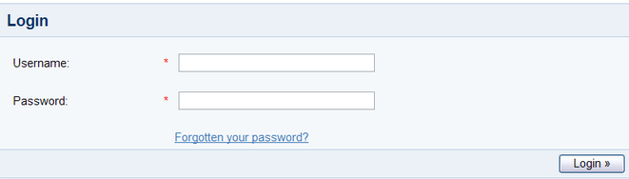
Problem Statement
Develop an image management utility. This utility begins by presenting a login screen that looks like this
User would enter an username and password for authentication. Upon clicking the Login button, the submitted username / password should be verified (authenticated) against existing users information in the database.
Upon successful authentication, the user would be presented with a screen as follows:

Slide 21
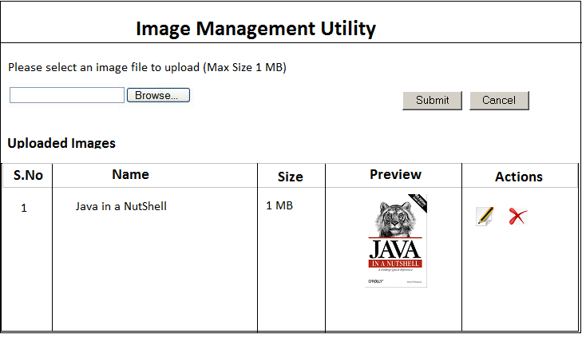
Problem Statement…
User should be allowed to edit (change the uploaded image’s attributes viz. name, image source) and delete the image and total size of the uploaded images should be displayed at the bottom of the listing on the same page.

Slide 22
Expected Behaviour
Constraints
Max size of a single file uploaded should be 1 MB
Max size of all uploaded files should be 10 MB
Key Points
Design appropriate data model and object model
Proper validation and info messages should be shown on console where ever required
Exception Handling is required
Make use of Hibernate Technology for Data Base connectivity
While writing APIs no SQL scripts should be used instead use Hibernate POJOs and HQL
Tomcat version 8 or above and hibernate 5.x should be used
Integrate SONAR and Jenkins

Slide 23
Evaluation Criteria
Code Completeness and Correctness
Usage of OO Principles, package/class structure, class/function/variable names
Code Modularity
Code should be in running condition
Face to face discussion
Data base design and proper use of hibernate technology
Adhere to Java Coding Standards And Guidelines
Jenkins and SONAR integration

Slide 24

Day 13- Day 17 Spring and Spring Hibernate Integration

Slide 25

Spring And Spring Hibernate Integration
Course Content
Spring Basics (Duration 7h)
Introduction
Spring Architecture
Spring Env. Setup
Write a small “Hello world” Example
Objective
Develop Web Application using Spring
Spring Hibernate Integration
Understanding Coding Guidelines and Best Practices
Spring Core (Duration 24h)
IOC/Dependency Injection
Validation, Data Binding and Type Conversion
Spring AOP
Transaction Management
Spring MVC
Spring JDBC Framework
Hibernate with Spring

Slide 26
Module Plan
Day | Activities
Day#13 | Spring Env Setup | Spring Fundamentals | Web Applications with Spring |Spring Tutorials Pdf [Spring Architecture]
Day#14 | Spring with JPA and Hibernate | Spring MVC Introduction
Day#15 | Spring Hibernate Integration | Spring Framework Reference
Day#16 | Spring Framework Reference | Assignment#3
Day#17 | Assignment#3

Slide 27
Study Material
Books
Spring Tutorial [5h]
Spring-framework-reference [8h] – (Study Material)
Video Material
Spring Fundamentals [2h 55m]
Web Applications with Spring [2h]
Spring with JPA and Hibernate [5h]
Spring MVC Introduction [4h]
Spring Hibernate Integration [1h 13m]

Slide 28
Assignment
Assignment # 3

Slide 29
Problem Statement
Implement a flight search Web Application using Spring, Hibernate technology that lists matching flights for a traveller who is looking to fly between 2 locations on a given date. The input locations should be 3 letter location code format as present in airlines flight data
You are given 3 CSV files, each containing the available flight data for Air India, Jet Air, IndiGo respectively. Sample CSV files links are attached here for reference. You can add more data in existing files or can add more CSV files for another airlines
Air India Data
Jet Air Data
Indigo Data

Slide 30
Problem Statement
CSV File Data Details
CSV Fields | Details
FLIGHT_NO | Unique flight number, starting with 2 letter airline code
DEP_LOC | Departure location code
ARR_LOC | Arrival location code
VALID_TILL | Date (DD-MM-YYYY) till which each flight is available. It means that this flight will fly once everyday till this date
FLIGHT_TIME | local time (HHmm) at which flight departs from departure location
FLIGHT_DUR | Flight Duration from departure location to arrival location
FARE | This is the fare of the flight per person in INR
SEAT_AVAILABILITY | Y or N
CLASS | E or B or EB [E- economic, B- Business]

Slide 31
Problem Statement
Input
Program should accept 5 input parameters
Departure Location
Arrival Location
Flight Date
Flight Class
Output Preference
“Flight Class” is a String which has two possible values like ‘E’ and ‘B’. E=Economic and B=Business.
“Output Preference” is a String which suggests whether flight result should be sorted only by fare or by both fare and flight duration.

Slide 32
Expected Behaviour And Output
Create Database tables in MySql Database for flight detail records (csv file data) and inserts the data using SQL
Create a login Page for the application and after successful login Flight Search Screen will be displayed
Search screen should have all input parameters specified in previous slides as Departure Location, Arrival Location, Flight Class, Flight Date, Output Preference
Once Search is triggered after specifying the search parameters, It will display the search results using hibernate
Use Spring MVC and Spring - Hibernate Integration
Spring version 3 or 4 should be used

Slide 33
Evaluation Criteria
Code Completeness and Correctness
Usage of Spring Framework And Hibernate
Code Modularity
Code should be in running condition
Face to face discussion
Application UI Design

Slide 34

Day 18- Day 22 Web Services

Slide 35
Web Service
Objective
Develop Web Application using Web Services
Course Content
Basics(Duration 11h)
Introduction
REST Core Components
SOAP Core Components
Advance (Duration 19h)
RESTful Architecture
HTTP methods
Jackson
Validations
Filters
REST with JAX-RS, Jersey, Apache CXF
Webservices with Apache CXF

Slide 36
Module Plan
Day | Activities
Day#18 | REST Webservices Basics | REST Webservices | SOAP | WSDL
Day#19 | SOAP Webservices Basics | RESTful Webservices with JAX-RS
Day#20 | RESTful Services in Java using Jersey | Building Asynchronous RESTful Services With Jersey
Day#21 | REST Services using CXF | Web Services with Apache CXF | Assignment#4
Day#22 | Assignment#4

Slide 37
Study Material
Books
REST Webservices Basics (Refer chap. 20) [4h]
REST Webservices [2h]
SOAP [30m]
WSDL [30m]
SOAP Webservices Basics (Refer chap. 16) [4h]
REST Services using CXF [2h]
Further References
Video Material
RESTful Webservices with JAX-RS [6h]
RESTful Services in Java using Jersey [4h 24m]
Building Asynchronous RESTful Services With Jersey [3h 11m]
Web Services with Apache CXF [3h 17m]

Slide 38
Assignment
Assignment # 4

Slide 39
Problem Statement
Develop a web application (Application 1) using Spring MVC and JSP for HR Manager. HR manager can login to application and manage employees.
However the details of the Employees are maintained on a separate server (Application 2) which exposes RESTful webservices using Jersey/CXF to support CRUD operations on employee data.
Following functionalities are expected
HR Manager Login/Logout
Employee listing
Edit an employee details

Slide 40
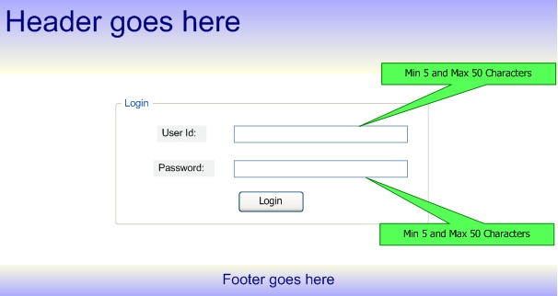
Application UI
HR Manager Login

Slide 41
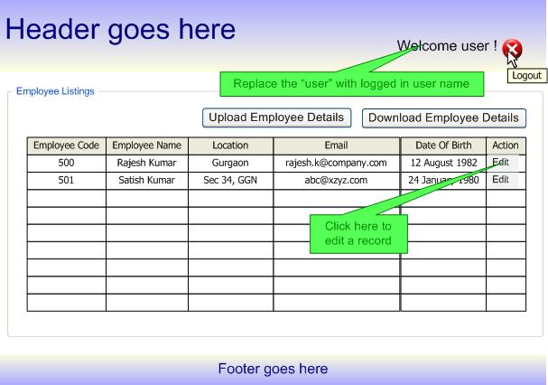
Application UI…
List Employees Details

Slide 42
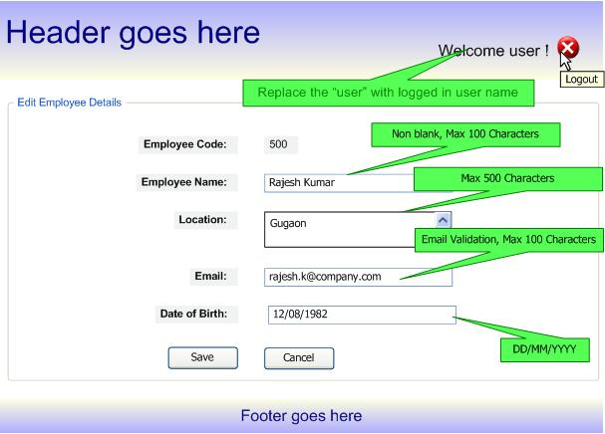
Application UI…
Edit Details

Slide 43
Expected Behaviour and Output
The complete assignment should be done using Spring MVC, Jersey, Tomcat, and Hibernate only.
Well documented HTML, JS and CSS files
Code should follow Java Coding Standards, Guidelines and best practices
Follow best practices for restful webservices
Server to server webservice communication

Slide 44
Evaluation Criteria
Code correctness
Code modularity
Code should be in running condition
Face to face discussion
Adhere to Java Coding Standards And Guidelines
Implementation of 3-tier architecture

